Slide 1
Docker Fundamentals
Dr. Prashant Aparajeya

Slide 2
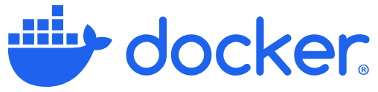
Docker
Docker is an open platform for developers and sysadmins to:
build,
ship, and
run distributed applications,
whether on laptops, data center VMs, or the cloud.

Slide 3
Objectives
What are Containers?
What is Docker?
Why do you need it?
What Can it do?
Run Docker Containers
Create a Docker Image

Slide 4
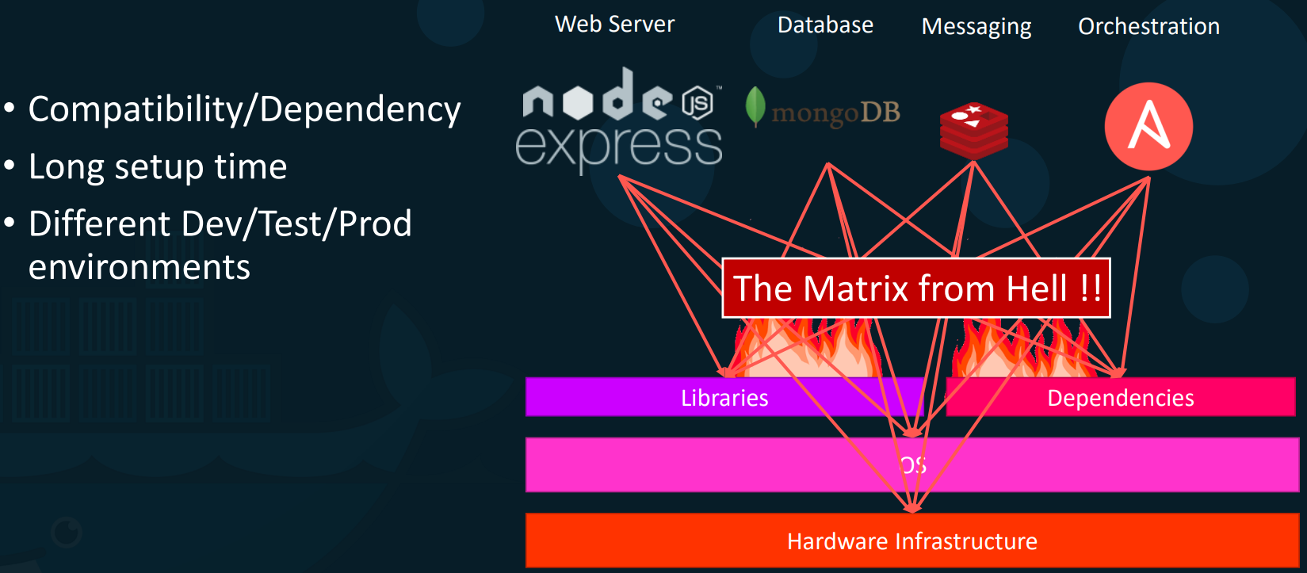
Why do you need docker?

Slide 5
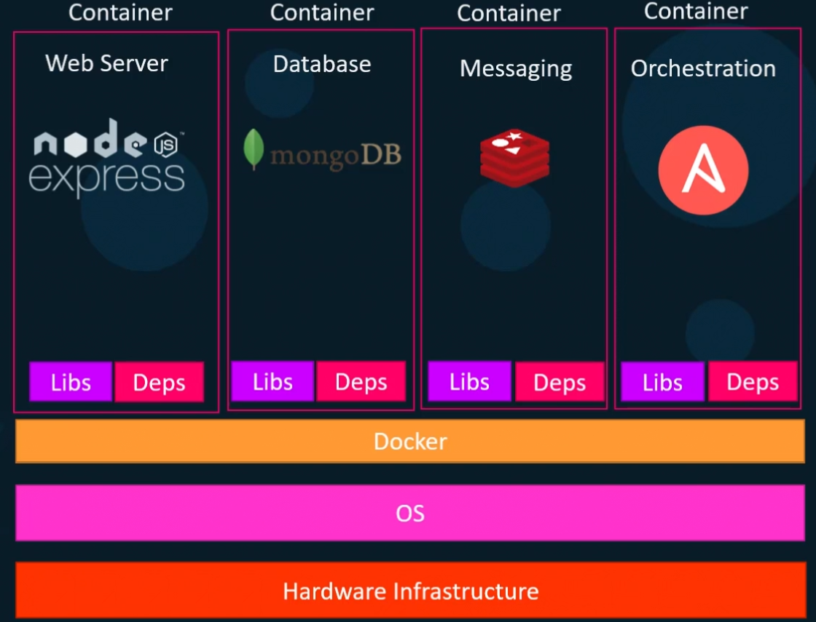

Slide 6
What can it do?
Containerize the solution
Run each service with its own dependencies in separate containers
Make sure the Docker is installed on the System

Slide 7
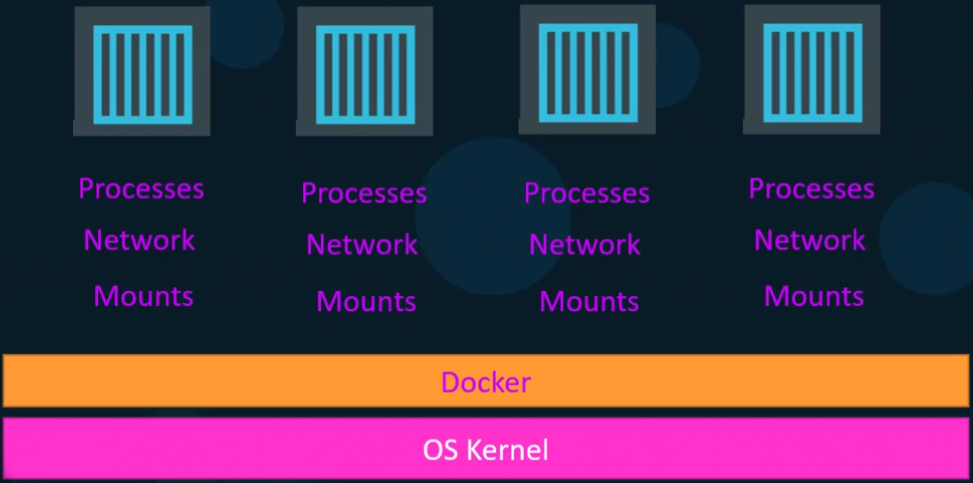
What are containers?
Containers are completely isolated environments as in they can have their own:
Processes
Network
Mounts
NB: They all share the same OS kernel.
Docker is the host that runs containers.
Docker developed a Linux container technology – one that is portable, flexible and easy to deploy. Docker open sourced libcontainer and partnered with a worldwide community of contributors to further its development.
Tech Tips: Docker utilises LXC containers.

Slide 8
Purpose of Docker
The main purpose of Docker is to:
Package,
Containerize Applications,
Ship them
Run them anywhere, anytime, as many times as you want.

Slide 9
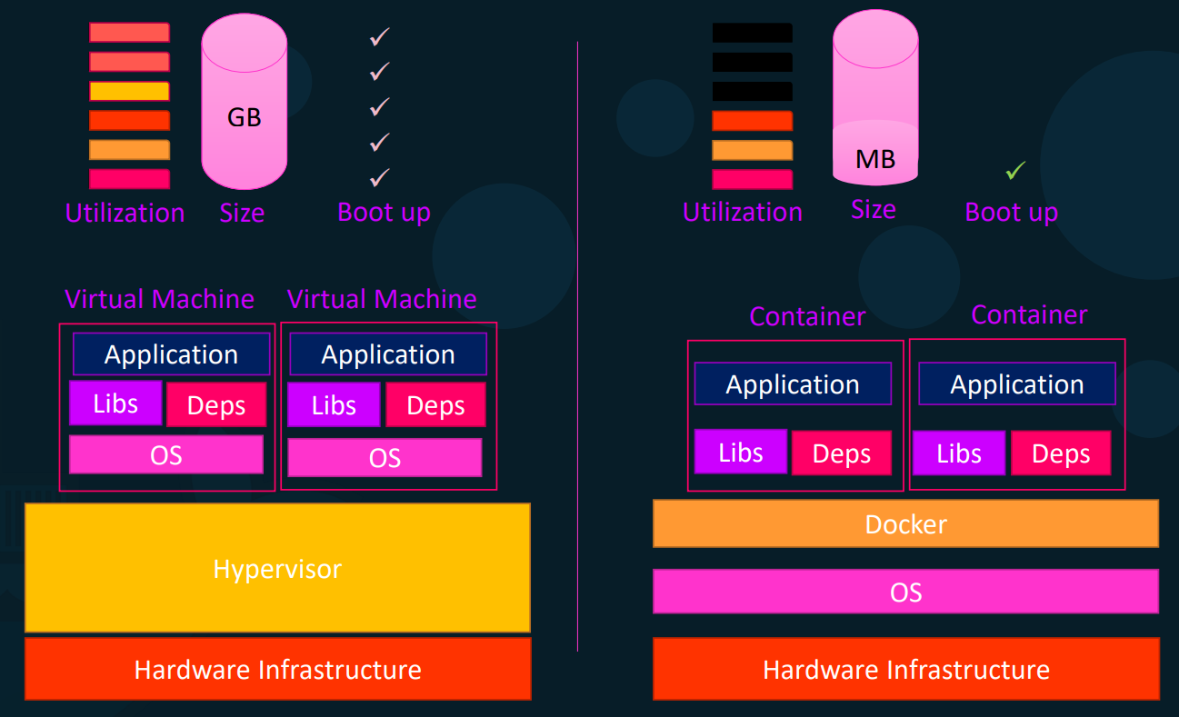
Containers vs Virtual Machines

Slide 10
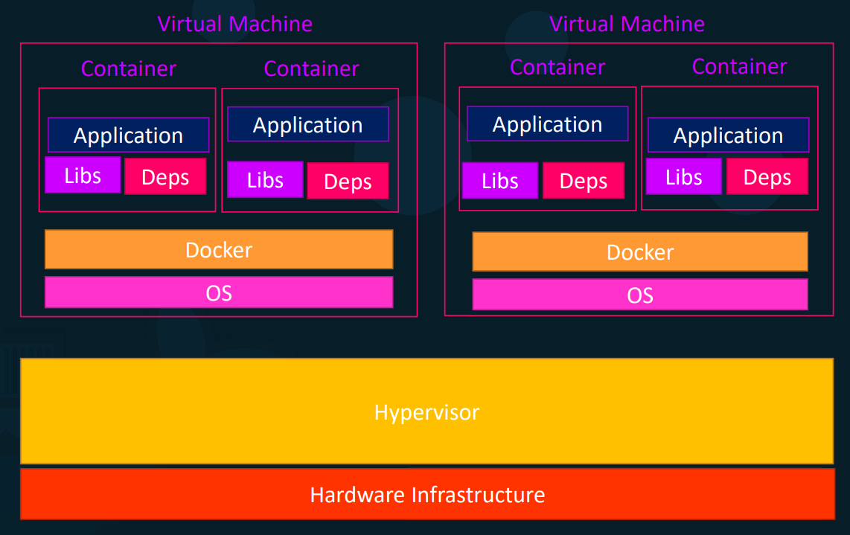
Containers & Virtual Machines

Slide 11
Installing and Running Docker
Check this URL: https://docs.docker.com/engine/install/
Check for the right OS and version on the left side panel and then follow the instructions.
$ sudo docker version
$ sudo run docker/whalesay cowsay Hello there!

Slide 12
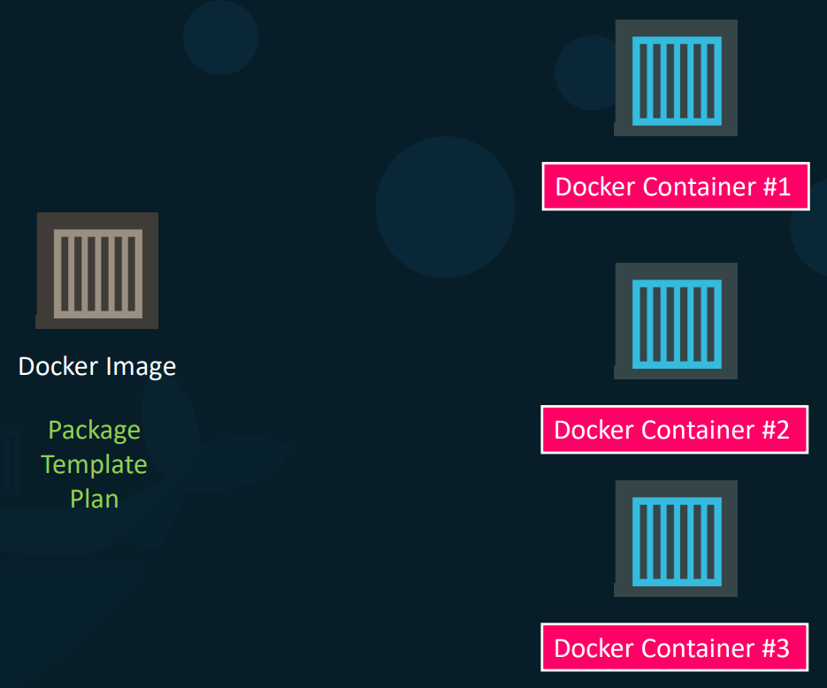
Container vs Image

Slide 13
Basic Docker Commands
Run – start/run a container from an image
$ docker run nginx
Note: If the container image already exists on the local system, Docker runs it immediately. Otherwise, Docker pulls the image from Docker Hub or another container registry (such as Google Artifact Registry) before running it.

Slide 14
Basic Docker Commands
$ docker ps # list running containers
$ docker ps -a # list all containers
$ docker stop <container_id> # Stop the container.
$ docker stop <container_name> # Stop the container.
$ docker rm <container_name/id> # Removes the container from memory
$ docker images # List images
$ docker rmi <image_name> # Delete the image. (NB: Make sure all dependent containers are stopped and removed before deleting the image)

Slide 15
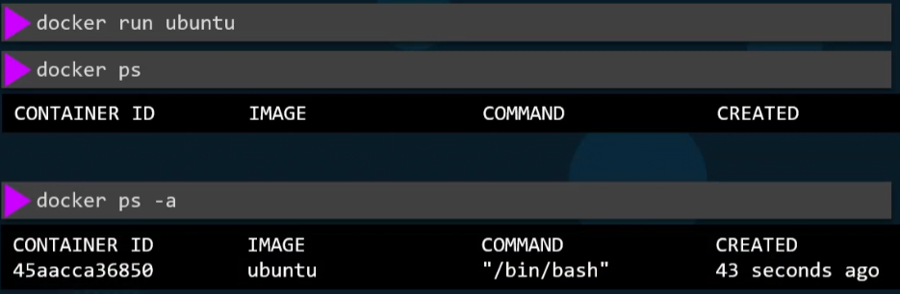
Basic Docker Commands
$ docker pull nginx # To only pull (or download) the image
$ docker run ubuntu # It will download and run the ubuntu container and will exit immediately
This happens because containers are not designed to host an entire operating system but rather to execute specific tasks or processes.

Slide 16
Basic Docker Commands
$ docker run ubuntu sleep 5 # It will now start the container and run a command sleep and will go to sleep for 5 secs. Then the container will stop.
$ docker exec <container_name> cat /etc/hosts # execute a command inside this container

Slide 17
Run – attach and detach
$ docker run docker run -p 8080:80 nginxdemos/hello # This is the attach mode and nothing else can be done on the terminal
$ docker run docker run -d -p 8080:80 nginxdemos/hello # This is the detached mode and the control on the terminal will be given back. Docker container will run in the background mode. Now you can run other commands on the prompt.
$ docker attach <container_id/name> # attach the background running container to the prompt.
Note: When specifying the container ID, you can provide just the first few characters instead of the full ID.

Slide 18
Docker Run Command
$ docker run -it centos bash # Interactive terminal mode with bash prompt.
To view the output, try running cat /etc/*release* in interactive terminal mode.
Type exit to exit the interactive terminal mode.

Slide 19


Run – tag
$ docker run redis # When no tag specified, uses “latest” as tag
$ docker run redis:7.4 # specified version is pulled

Slide 20
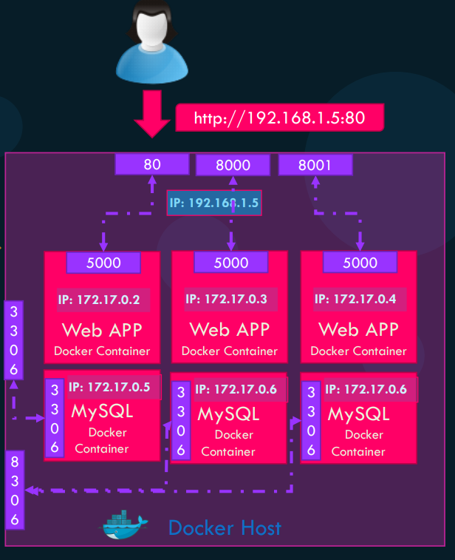
Run – PORT mapping
$ docker run docker run -p 8080:80 nginxdemos/hello # Container’s 80 port is mapped to port 8080 and now the host can access it via 8080 port.

Slide 21
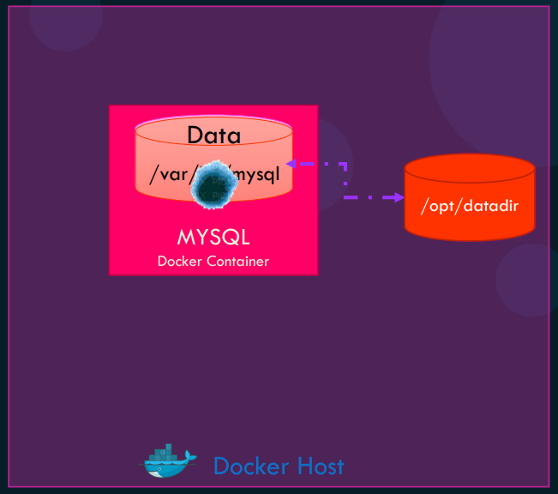
Run – Volume mapping
$ docker run -v /opt/datadir:/var/lib/mysql mysql # Container’s volume /var/lib/mysql is not mounted to /opt/datadir on the local (host) system. All data will be replicated/preserved.

Slide 22
Inspect Container
Container Logs
$ docker inspect <container_name> # Details about the container
$ docker logs <container_name> # Logs generated inside the container

Slide 23
ENV Variables in Docker
$ docker run -e APP_COLOR=blue simple-webapp-color
import os
from flask import Flask, render_template
app = Flask(__name__)
# Get the color from the environment variable APP_COLOR, default to "red" if not set
color = os.environ.get("APP_COLOR", "red")
@app.route("/")
def main():
print(color) # Log the color to the console
return render_template('hello.html', color=color)
if __name__ == "__main__":
app.run(host="0.0.0.0", port=8080)
$ export APP_COLOR=blue; python app.py

Slide 24
How to create my own image?
Dockerfile
FROM Ubuntu
RUN apt update
RUN apt install python
RUN pip install flask
RUN pip install flask-mysql
COPY . /opt/source-code
ENTRYPOINT FLASK_APP=/opt/source-code/app.py flask run
1. OS - Ubuntu
2. Update apt repo
3. Install dependencies using apt
4. Install Python dependencies using pip
5. Copy source code to /opt folder
6. Run the web server using “flask” command
$ docker build Dockerfile –t <myusername>/my-custom-app
Docker Registry
$ docker push <myusername>/my-custom-app

Slide 25
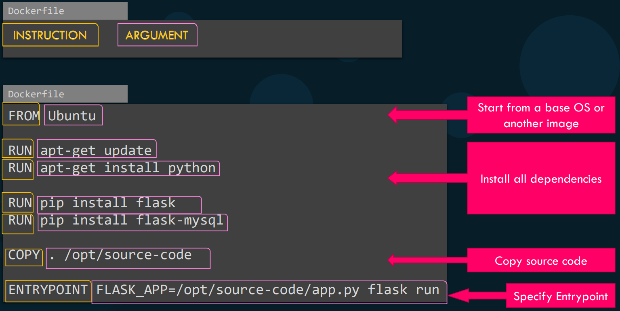
Dockerfile

Slide 26

Practice Coding – A LOT

Slide 27


